Slide 1
Devops Cookbook
Agenda:
Recap previous meeting
Present & share content
Review content proposals
Present teamplace
Capture & process feedback
Agree on next steps

Slide 2

Devops change initiative structure
DevOps CoE – Katarzyna Wojcik
DevOps pilots – Marcin Klimkiewicz
DevOps ecosystem – Evelien Deman
DevOps technology & tools – Bartosz Celmer
DevOps change management/communication (incl. Training material) – Evelien Deman
Devops Skills capability – Prabhu Shreesha
Overall coordination: Evelien Deman
Overall coordination by Evelien Deman

Slide 3


Devops Ecosystem Track: two main subdeliverables
Implementing Devops ways of working on some or our development teams, will need adaptations of some of our IT Directives, Processes, Methods and Frameworks.
Ambition: Secure existing materials are devops compatible
There is a need to secure that people understand what minimum ingredients they need to think of, and how to combine them, when doing “devops way”
.
Ambition: Show the devops way

Slide 4
Next steps (from first kickoff)
Team:
- lacking Java world: Bartek
Approach:
Will split the work amongst ourselves
Bring it together: next session in two weeks time
Target launch: 1 of october, teamplace ready!.
Action list:
Each should work in his submaterial
Evelien will book the follow up session in two weeks
Evelien to contact for the practicalities of the site

Slide 5

Devops
Cook Book
Target date launch 1/10/2017

Slide 6

Cook book
What:
There is a need to secure that people understand what minimum ingredients they need to think of, and how to combine them, when doing “devops way”
How: website
Ambition:
easy to find entry point
be a guide on how to “start” or “do” devops in the Volvo context
refer to “market material” and standards where possible.
Owner: Devops COE

Slide 7
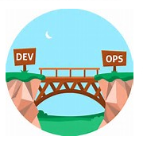
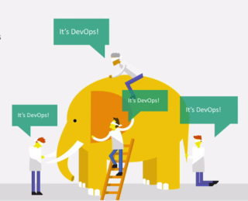






Cookbook Structure
Why devops?
What is devops?
Become devops?
Where can I learn more?
Devops Tools
Devops Culture
What about current WOW?
...........
Devops Pilots

Slide 8
Next slides contain per cookbook chapter*
Purpose of the chapter (this is for the working group, not to be posted)
Content proposal (this is what will be put on the teamplace)
*(chapter = blue boxes on previous slide)

Slide 9
Why devops?
Purpose: explain the gains from Devops, for volvo group and for the individual. What is the underlying value proposition?

Slide 10
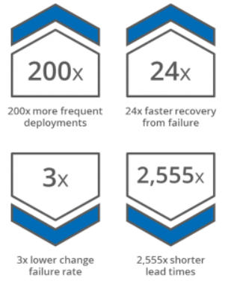
Why Devops
In today’s world, business agility is essential for Volvo group to stay competitive
Traditional IT development and IT operations silos don’t scale well for rapid response.
Market evidence shows that companies that incorporate DevOps practices get more done
Why adopt DevOps?
DevOps results*
1
Be responsive to business change.
2
Maintain stable, highly available IT infrastructure.
3
Deliver quality services that meet the needs of the business.
4
Provide a good user experience for the end customer.
Applicability:
current estimate is that within Volvo Group Devops could be relevant for 50% of the IT teams**
* Market data on devops implementations
** ref Gartner Bi model IT
Notes:
Background and what issues/opportunities the initiative will address. The scope should be broad enough to truly make a difference, but manageable to address in ~3 years

Slide 11




Why Devops: 4 R’s value proposition
Reliable: Every piece of developed, delivered and deployed software is of high quality, and the process for delivering and deploying it works smoothly with very minimal errors.
Repeatable: Software development, delivery and deployment processes are repeatable and objectively verifiable for high–quality. We can re-execute any part of this process over and over again whenever necessary.
Rapid: Software Development Life Cycle time can be made as short as possible— from concept to working delivered software that gets deployed into production can be as fast as possible
Return-on-Investment (ROI): The process of development, delivery and deployment occurs with minimal waste. The ratio of business value to software effort is as high as possible
Notes:
-Arun

Slide 12
What is devops?
Purpose:
Give a high level definition of devops
Highlight the key elements of devops
It should be on “management summary level”, even if the audience is not management but anyone who tries to understand what devops is.

Slide 13
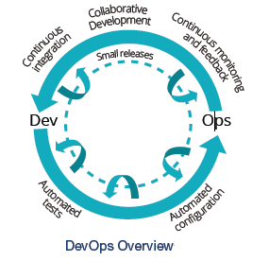
What is devops?
Content proposal, to be reviewed !
DevOps is the practice of operations and development engineers participating together in the entire service lifecycle, from design through the development process to production support.
development process to production support.
Culture People and process first. If you don’t have culture, all automation attempts will be fruitless.
Automation This is one of the places you start once you understand your culture. At this point, the tools can start to stitch together an automation fabric for Devops. Tools for release management, provisioning, configuration management, systems integration, monitoring and control, and orchestration become important pieces in building a Devops fabric.
Measurement If you can’t measure, you can’t improve. A successful Devops implementation will measure everything it can as often as it can… performance metrics, process metrics, and even people metrics.
Sharing Sharing is the loopback in the CAMS cycle. Creating a culture where people share ideas and problems is critical.
Allign with what efficode is thinking, waldemar

Slide 14
What is devops?
Content proposal, to be reviewed !
DevOps is the practice of operations and development engineers participating together in the entire service lifecycle, from design through the development process to production support.
Key features of devops mindset?
● Customer centric action
Making sure that deliver value for customer.
● End-to-end responsibility
Clear, common vision what is the goal and responsiblity for the delivery from the begining to the end.
● Cross-functional teams
Share knowledge, ideas and skills.
● Continuous improvement & innovative culture
Always asking a questions: what can be improved?
how can be improved? What can be automated?
● Test & infrastructure extensive automation
Automate every repetitious tasks.
● Application, infra and process meaningful monitoring
Monitoring which doesnt say anything and is hard to understand is a waste.
Allign with what efficode is thinking, waldemar

Slide 15
How do I “become devops”?
Owners: kasia
Purpose: this section should explain to people what they could/should do if they want to “become devops”. It could point to how to request devops service from Devops COE

Slide 16
How do I “become devops”?
Content proposal, to be decided
Coming soon !

Slide 17
How can I learn more on devops?
Owners: evelien
Purpose: this section should explain to people what they can learn more on devops. trainings to follow, material to read, etc….
The section should only point them on where to find the material and should not contain the material itself.

Slide 18

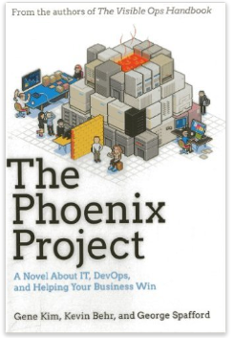
How can I learn more on devops?
There is a lot of interesting material on available on the internet on this topic. Below you can find some recommended links & recommended material to start your Devops Journey.
Interesting links:
Training
Pluralsight trainings
Devops conference 2017 Helsinki
You Tube
Books
What is DevOps? - In Simple English
Just search for devops on Youtube and you'll find lots of stuff
Contact Devops COE for more information
Notes:
https://youtu.be/_I94-tJlovg
https://youtu.be/_I94-tJlovg
https://www.youtube.com/results?search_query=devops

Slide 19
Devops Tools
Purpose:
Shows of the devops tools
Show where they fit into the devops concept
Connect it to the different technologies (java/.net – as a start)
Emphasize the importance of tools
Show where to find more details on the tools

Slide 20
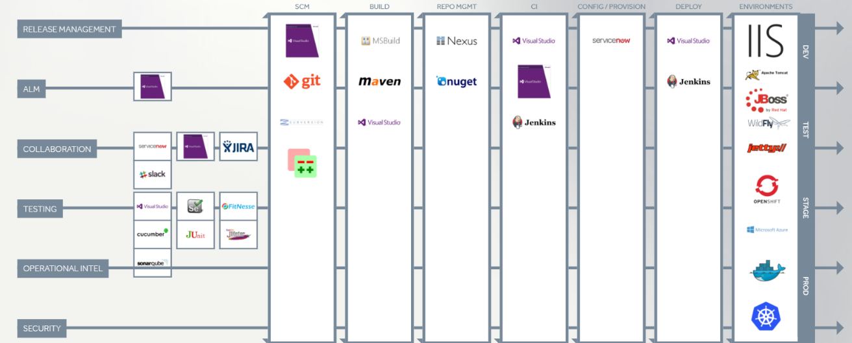
DevOps tools
Content proposal, to be reviewed
Owners: fabio, waldek

Slide 21
DevOps tools
Tools are very important to make DevOps happen
Tools allow us to speed up the delivery automating tasks
Tools may provide continous monitoring of the status of the delivery
Building, Testing, Deploying, Monitoring rely on tools

Slide 22
DevOps Tools
New Tools must be evaluated and added to help DevOps initiative
.NET (Current Scenario)
TFS
Git and TFVC (Source Controls)
Build (MSBuild) and Release Management (Deploy)
CI (Continuous Integration), Coded Testing
SonarQube (Code quality)
Nexus (Package Management) – NuGet, npm, docker
Java -> to be reviewed by some java guy
Git (Source Control)
Maven (Build)
Jenkins (CI and Deploy), Coded Testing
SonarQube (Code quality)
Nexus (Package Management) - npm, docker, bower
List of all tools at http://teamplace.volvo.com/sites/DevOps/SitePages/Home.aspx (IDEA: create a list with the tools, description and purpose and share it with all)

Slide 23
What about current WOW?
Purpose:
Create awareness that current methods, frameworks, processes and directives needs to be reviewed
Create awareness that this will happen over time, not in a big bang
Explain the “devops ready logo

Slide 24
What about current WOW?
Evelien
Devops is expected to be applicable for a large part of our teams
Current processes, methods , frameworks and directives were not written with Devops in mind
As for today, it is not clear what the devops impact will be on the above
Devops Ready Logo
Why Devops logo
1
Support teams in understanding which documents have been devops certified yet
2
Promote the devops thinking with the document owners
Applicability:
3
Provide a simple way to get an overall view on the devops maturity in our existing ways of working
All DRS processes, methods & frameworks and directives will be verified against Devops compliance. The assessment will be done by the Devops COE & will happen over time.
inventory
Notes:
Background and what issues/opportunities the initiative will address. The scope should be broad enough to truly make a difference, but manageable to address in ~3 years

Slide 25
Devops pilots
Purpose:
Inspire people to go the devops way via successstories, reference to team that are on the journey, reports to read .....
Put practical examples in the Volvo context as source for learning
Allow people to reach out to other teams that already did the devops journey (learning from peers)

Slide 26
Devops pilots
Owners: fredryk
Coming soon !
Content proposal

Slide 27
Devops culture
Purpose:
Highlight the importance of the devops culture
Explain high level the devops culture and its keycharacteristics

Slide 28
Devops culture
Coming soon !
Owners: arun
Content proposal

Slide 29
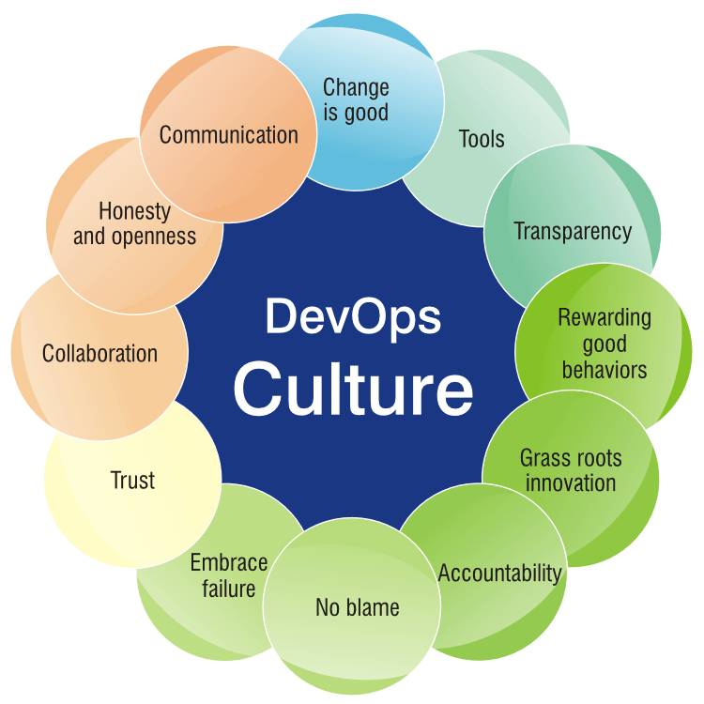
Devops culture
DevOps is a cultural & professional movement & it not job description / new team
CAMS*
creating a Culture
building Automation
Measuring everything
Sharing what happens
Notes:
*CAMS – John Wills in “What DevOps Means To Me” in 16/7/2010

Slide 30


Devops culture
Collaboration with shared values & behaviour:
Bringing the team members together; increase transparent communication, Join stand up meeting
Everyone on the same page:
What you’re doing ?
New feature
New test
New requirements
New tools

Slide 31

Devops culture
Learn to trust :
- Establish trust and transparency between Dev and Ops. ensuring that both sides of this equation agree when it comes time to shipping software.
- Have unified agreement and understanding that we all represent the same team

Slide 32


Devops culture
Be supportive:
No-Blame game, as a team we succeed & focus towards converting negative to positive.
Learn & Experiment:
Learn from mistakes
Take risk by implementing small changes
Share your experience

Slide 33

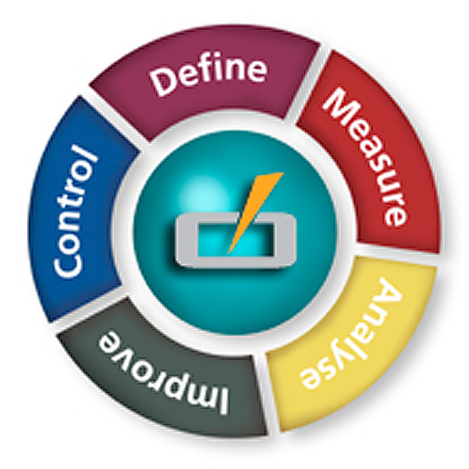
Devops culture
Continuous Improvement:
Look for continuous improvement to increase the rate of success & business results
Be Continuous:
integrate code
test
integrate
deploy
deliver
fund
Notes:
Continuous funding allows budgets to be accessed and funds to be drawn as the incremental changes require them.

